Slide 1
INTRODUCTION TO COMPUTING
Course Code: CCINCOM/L
Greedy Algorithms
Joseph Marvin R. Imperial
Manolito V. Octaviano Jr.
Faculty
Department of Computer Science
College of Computing and Information Technologies (CCIT)
National University
Joseph Marvin R. Imperial
ALGORITHMS AND COMPLEXITY
NU College of Computing and Information Technologies
Course Code: ALGOCOM

Slide 2
Greedy Algorithms
take the best solution you can get right now, without thinking of past record or future consequences. Hence the word ‘greedy’.
hope that by choosing a local optimum (local solution) at each step, you will end up at a global optimum (overall solution).
not always guaranteed to produce the optimal solution.
faster than divide-and-conquer and DP
ALGORITHMS AND COMPLEXITY
Course Code: ALGOCOM

Slide 3
If both of the properties are true, a greedy algorithm can be used to solve the problem.
Greedy choice property
A global (overall) optimal solution can be reached by choosing the optimal choice at each step.
Optimal substructure
A problem has an optimal substructure if an optimal solution to the entire problem contains the optimal solutions to the sub-problems.
ALGORITHMS AND COMPLEXITY
Course Code: ALGOCOM

Slide 4
Example problems for greedy algorithms
Traveling one place to another weighing cost and travel time
Best car selection based on features
Shortest path down a tree
The change number
Knapsack problem
Fractional knapsack problem
Activities selection problem
ALGORITHMS AND COMPLEXITY
Course Code: ALGOCOM

Slide 5
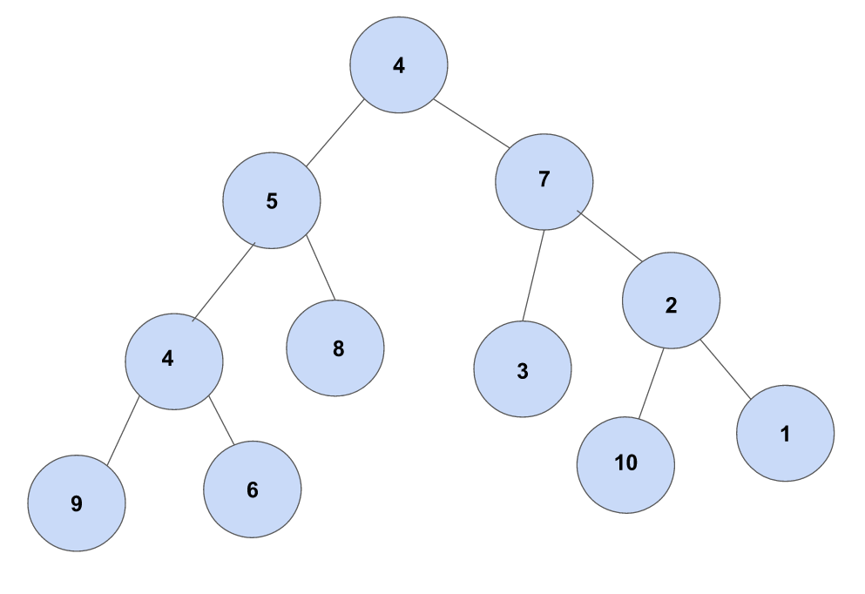
What is the greedy approach to get the largest sum by traversing the tree?
ALGORITHMS AND COMPLEXITY
Course Code: ALGOCOM

Slide 6
The Change Problem
Instruction:
Return/represent an amount of money, using the fewest possible bills and coins.
Assume that you have only have coins of values {1, 5, 10, 20}, what would be the greedy approach to represent 36 with the fewest possible coins?
ALGORITHMS AND COMPLEXITY
Course Code: ALGOCOM

Slide 7
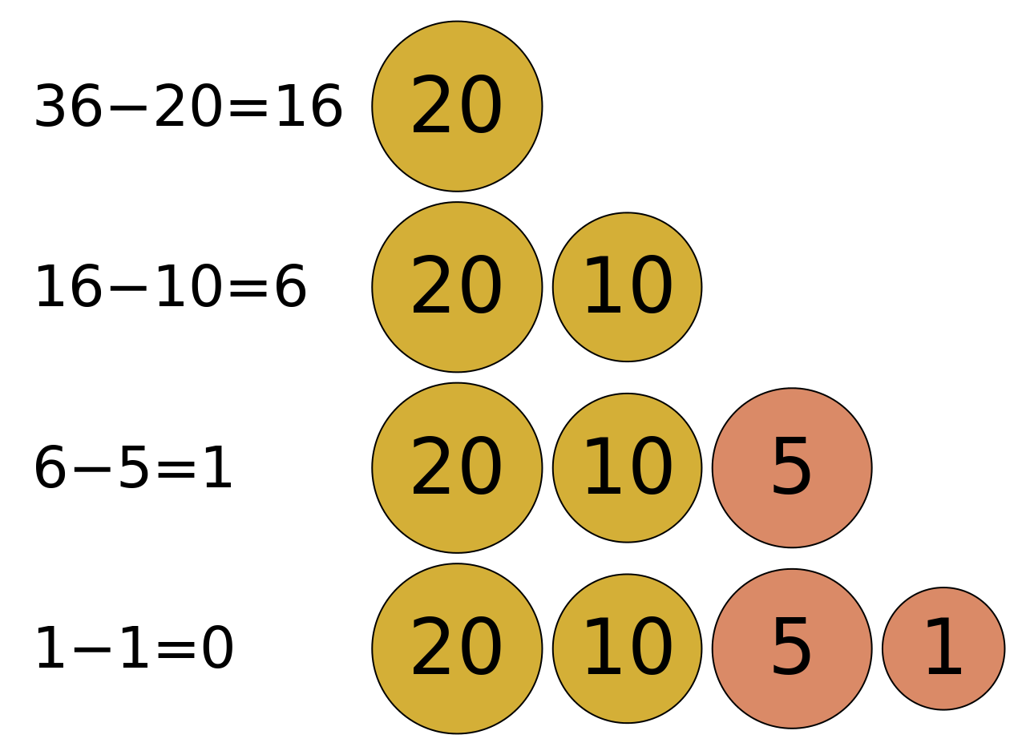
The Change Problem
ALGORITHMS AND COMPLEXITY
Course Code: ALGOCOM

Slide 8
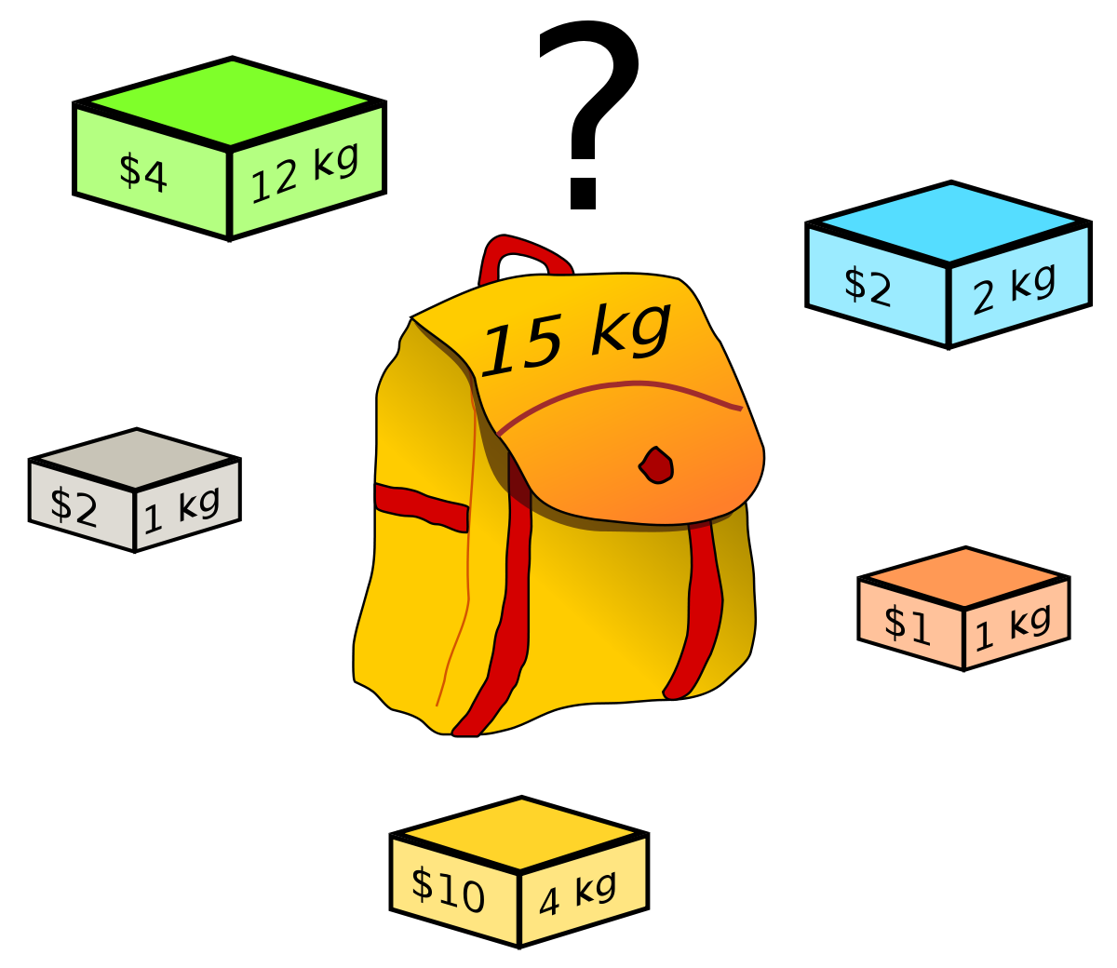
The Knapsack Problem
Instruction:
Given weights and values of n items, put these items in a knapsack of capacity W to get the maximum total value in the knapsack.
ALGORITHMS AND COMPLEXITY
Course Code: ALGOCOM

Slide 9
The Knapsack Problem (Greedy Solutions)
Version #1:
Among the remaining items, grab the item with largest profit value that would fit in the knapsack.
Version #2:
Among the remaining items, grab the item with the largest value-for-weight that would fit in the knapsack
ALGORITHMS AND COMPLEXITY
Course Code: ALGOCOM

Slide 10
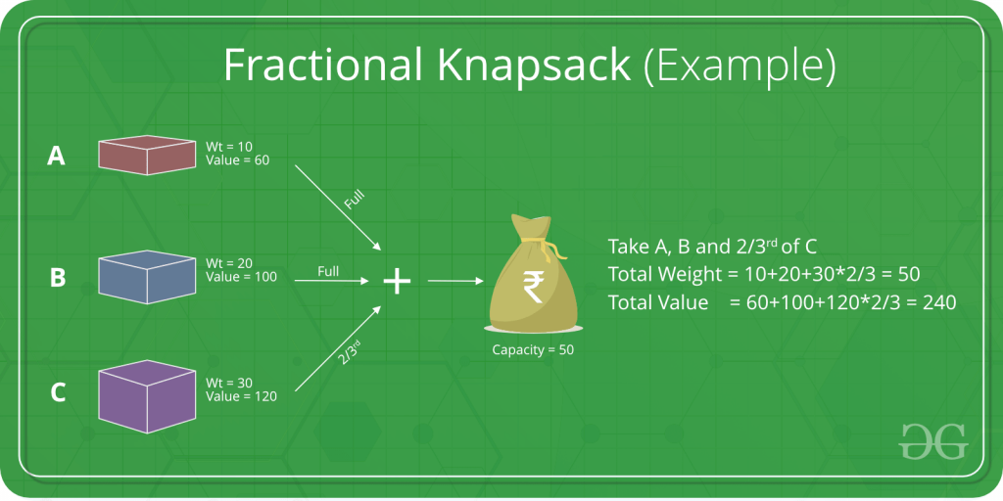
The Fractional Knapsack Problem
ALGORITHMS AND COMPLEXITY
Course Code: ALGOCOM

Slide 11
Activities Selection Problem
You are given n activities with their start and finish times. Select the maximum number of activities that can be performed by a single person, assuming that a person can only work on a single activity at a time.
Activity A = {10, 20}
Activity B = {12, 25}
Activity C = {20, 30}
Say you are only allowed to participate to 2 activities maximum. How will you identify which activities to participate in?
ALGORITHMS AND COMPLEXITY
Course Code: ALGOCOM

Slide 12
Activities Selection Problem (Greedy Solution)
The greedy choice is to always pick the next activity whose finish time is least among the remaining activities and the start time is more than or equal to the finish time of previously selected activity.
Possible Rule of Thumb: We can sort the activities according to their finishing time so that we always consider the next activity as minimum finishing time activity.
ALGORITHMS AND COMPLEXITY
Course Code: ALGOCOM

Slide 13
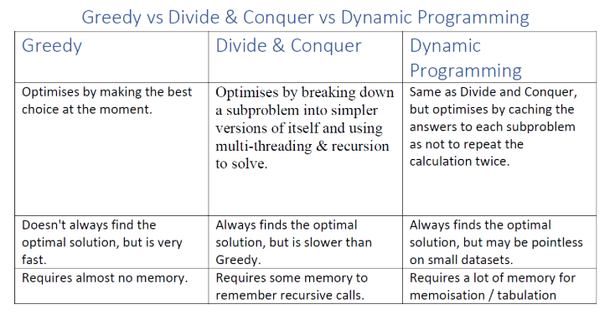
ALGORITHMS AND COMPLEXITY
Course Code: ALGOCOM

